Slide 1

City of San Antonio 2021 Employee Compensation
An exploratory data analysis by:
Dan Schumacher

Slide 2
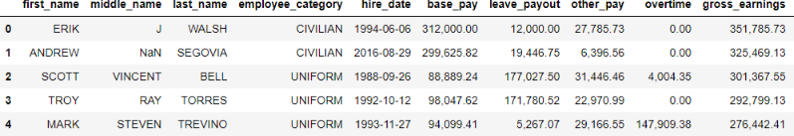
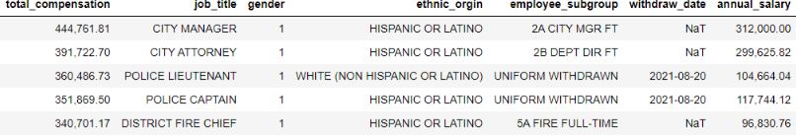
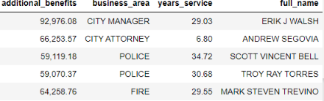
Here is our what the COSA Employee Compensation data base looks like. Rows are individual employees who work for the city Columns are variables (name, ethnic origin, gender, types of compensation etc.)

Slide 3
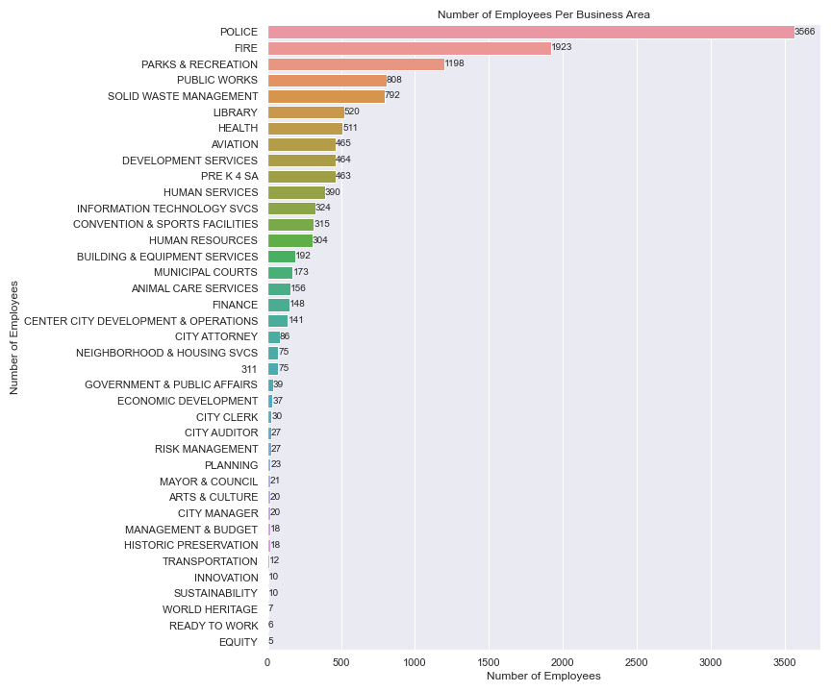

Slide 4
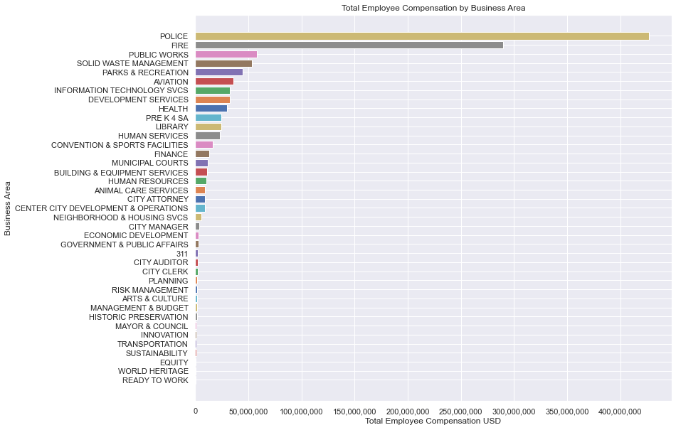

Slide 5
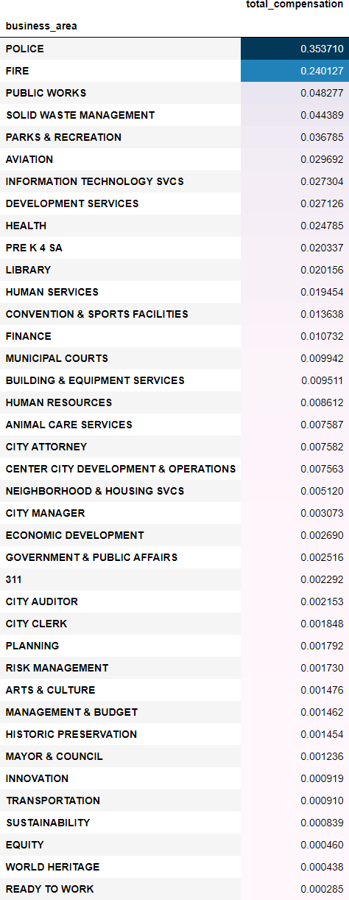
Percentage COSA’s total compensation by business area

Slide 6
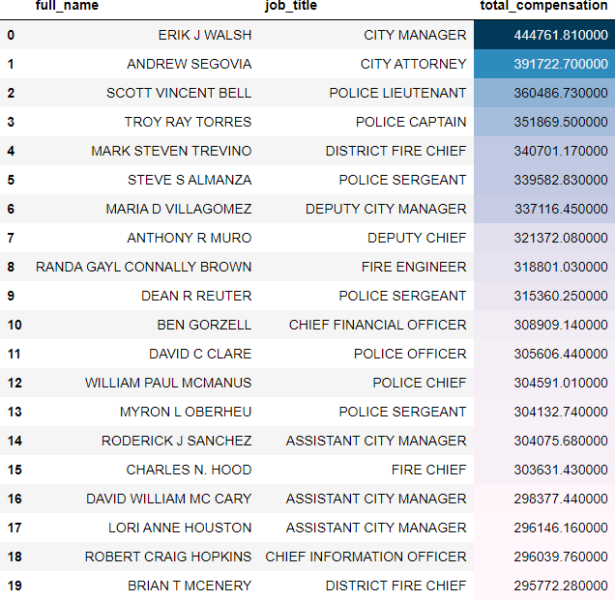
The twenty highest paid COSA employees

Slide 7
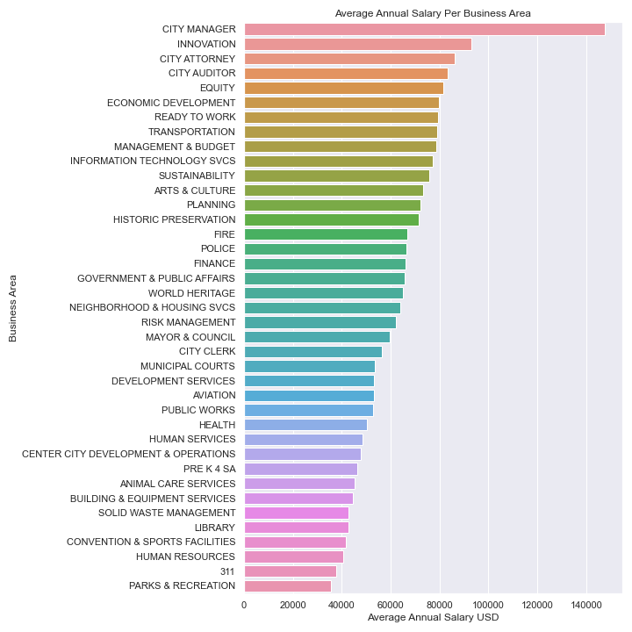

Slide 8
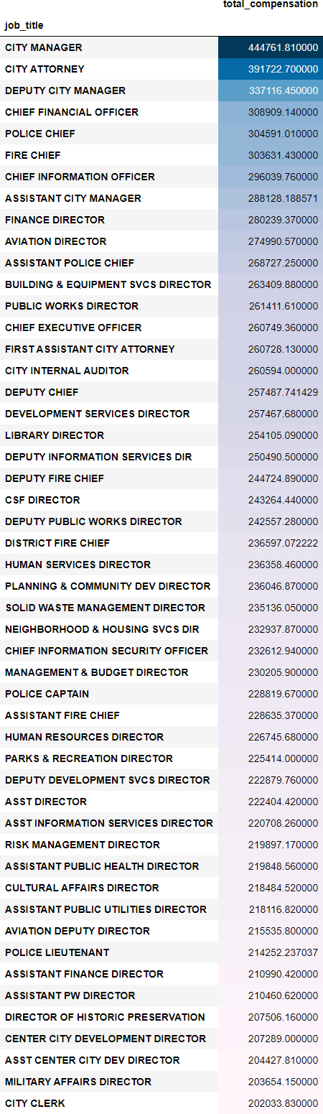
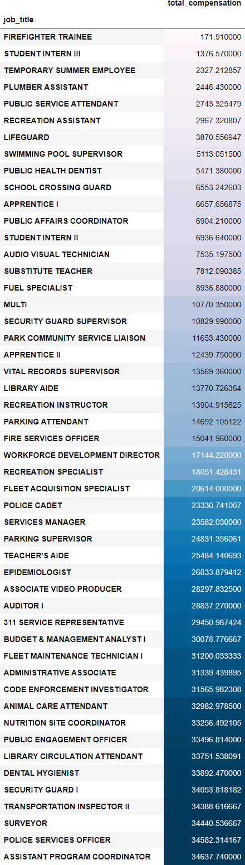
Highest Paying COSA Jobs
Lowest Paying COSA Jobs

Slide 9
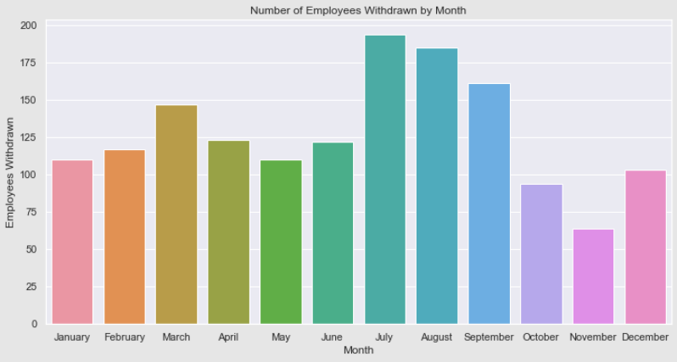

Slide 10
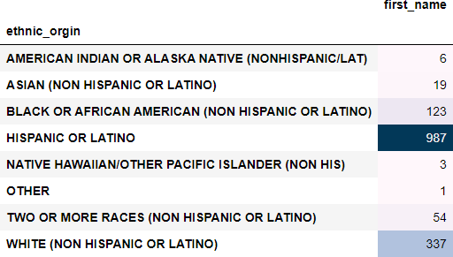
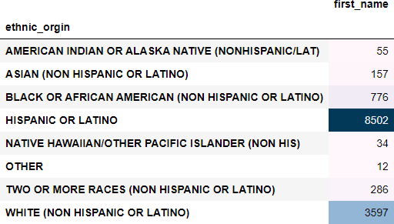
Total number of COSA employee's ethnicity
Number of COSA employees withdrawn by ethnicity

Slide 11
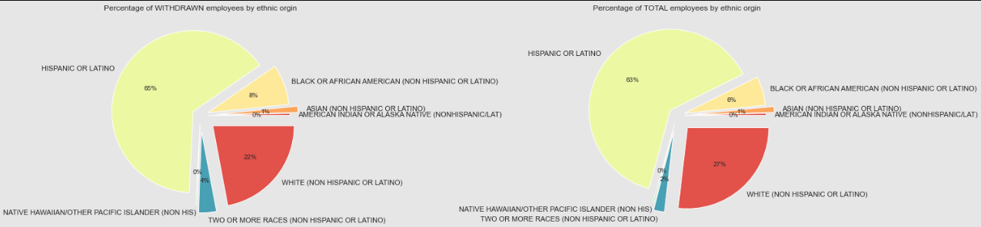

Slide 12
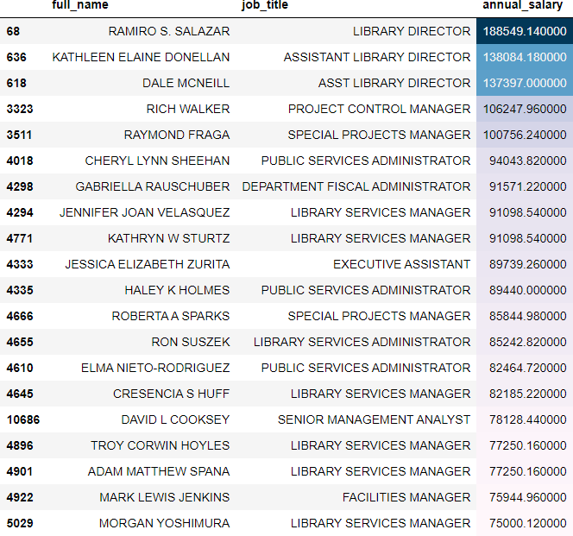
Top 20 highest paying library employees

Slide 13
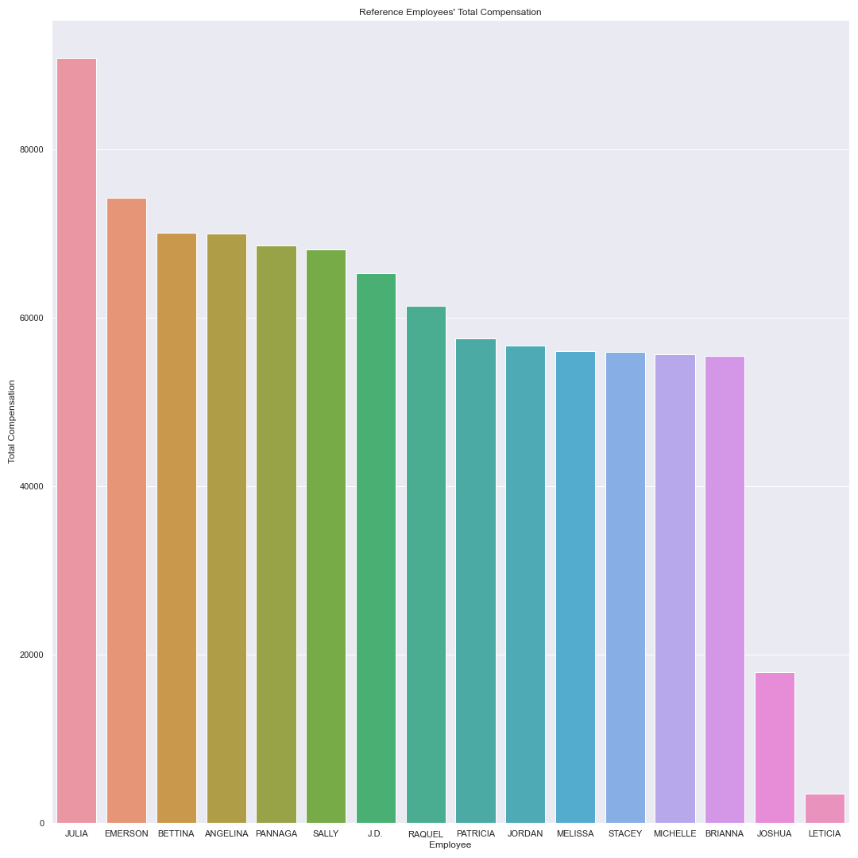
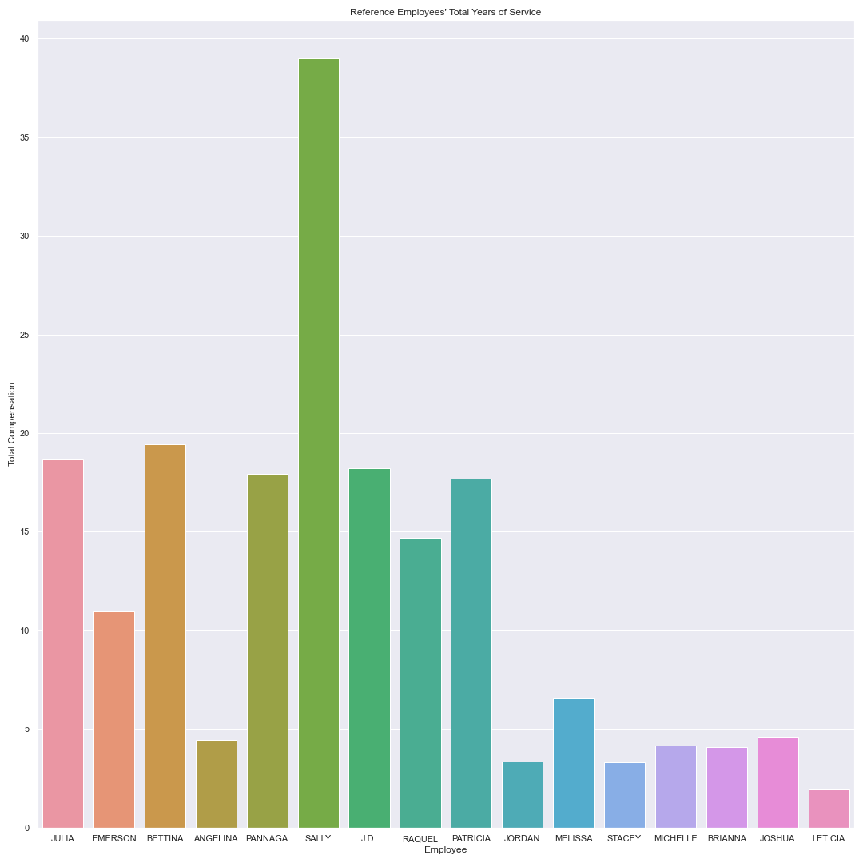
Reference Employees
Total compensation
Years of Service

Slide 14
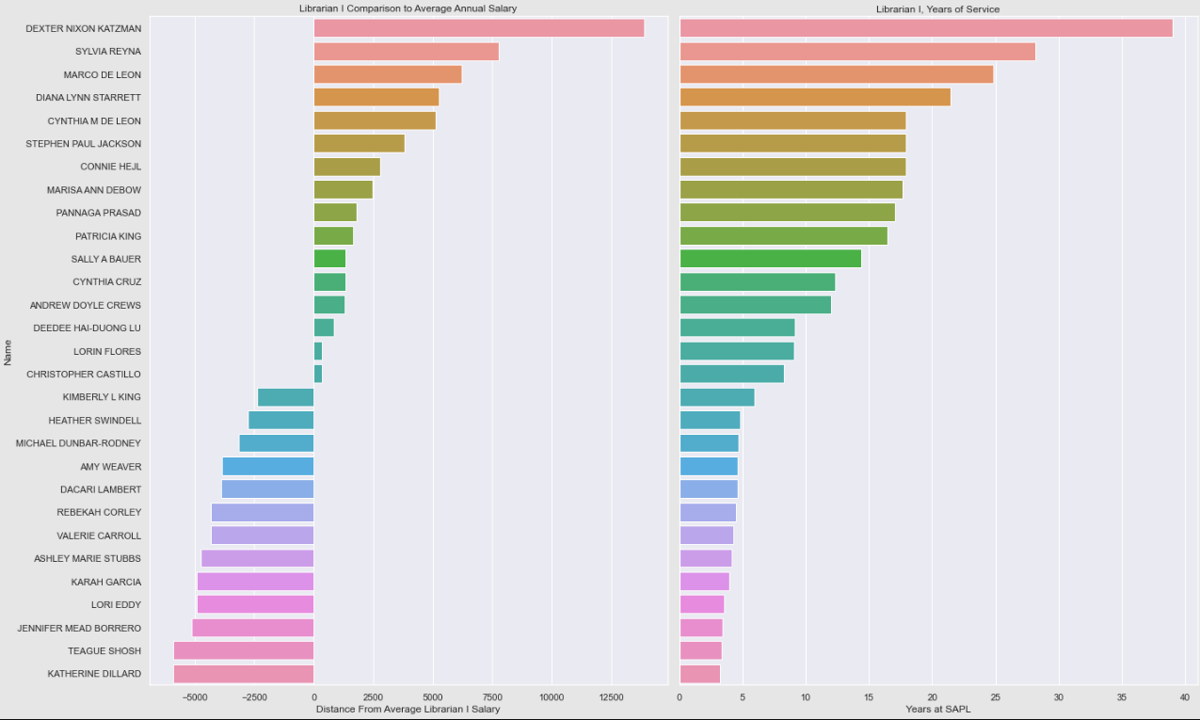
Librarian Is

Slide 15
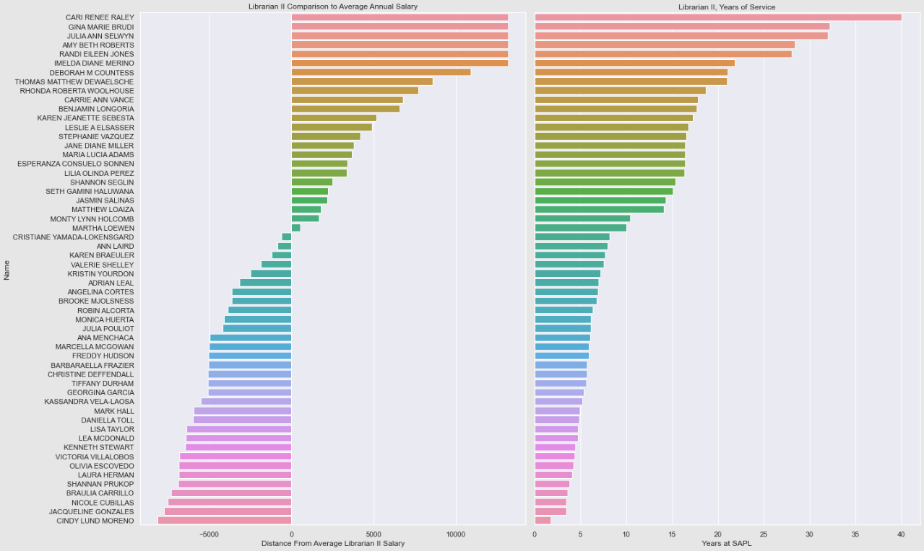
Librarian IIs

Slide 16
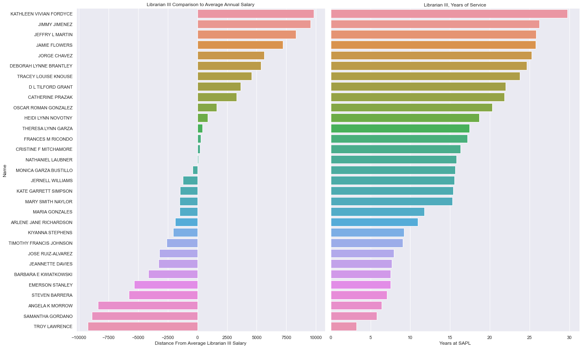
Librarian IIIs

Slide 17




Correlations
City Wide
Library Department
Gender vs Annual Salary
Total compensation vs years of service

